Slide 1
Student E-Placement Web Application Using Cloud
Guide,
K . Suresh,
Associate Professor.
By,
G.A.Venkateshwaran(921315104229),
_{J.Suresh(921314104205),}
_{J.Surya(921315104209),}
_{V.Sri Rahul(921315104198).}

Slide 2
ABSTRACT:-
The E- PLACEMENT is a web based application for the placement department of the college in order to provide the details of its students in a database for the companies to their process of recruitment provided with a proper login. This system can used for college to manage the student information with regards to placement details .This project contains all the details of the students that can be viewed by all the companies, but can be modified only by the student with an authorized service. Each and every detail will be controlled and coordinated by the placement coordinator. E-placement application can improve the campus recruitments easily.

Slide 3
INTRODUCTION:-
Cloud computing is an Information Technology (IT) paradigm that enables ubiquitous access to shared pools of configurable system resources and higher level services that can be rapidly provisioned with minimal management effort, often over the Internet. Cloud computing relies on sharing on resources to achieve coherence and economic of scale, similar to a utility over a network. Cloud computing, or in simpler short hand just “The cloud”, also focuses maximizing the effectiveness of the shared resources. Cloud resources are usually not only shared by multiple users but are also dynamically reallocated per demand. This approach should maximize the use of computing power thus reducing environmental damage as well since power less, air conditioning, rack space, etc., are required for variety of functions.

Slide 4
INTRODUCTION (Contd.,)
Cloud providers typically use a “pay-as-you-go” model, which can lead to unexpected operating expenses if administrators are not familiarized with cloud pricing models.
This information is accessible Nationwide with the Unique ID. This application makes the maintenance of record simple and handy. This System enables ease of access to the Users.

Slide 5
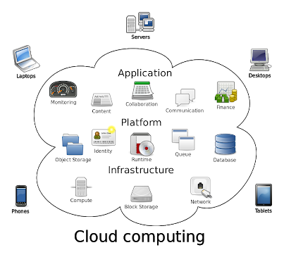
INTRODUCTION (Contd.,)

Slide 6
AIM:
E- PLACEMENT is a total management and informative system, which provides the up-to date information of all the students in a particular college.
PROBLEM DEFINITION:-
Now a day’s campus placements are conducted in all colleges. Various software and other sector companies are conducting campus selections for selecting merit candidates. When campus selections are conducted the students should provide their curriculum vitae to the concern officer for attending the campus interviews. This routine process is maintained manually, like maintenance of their resumes in papers. This can be automated by designing software.

Slide 7
LITERATURE SURVEY:-
S.N | EXPERIMENT NAME | AUTHOR NAME | OBJECTIVE | ADVANTAGES/ DISADVANTAGES
1. | Web Based Placement Management System | Anjali.V, Jeyalakshmi.PR, Anbubala.R, Sri Mathura devi.G,Ranjini.V | Student logging should be able to upload their personal and educational information in the form of a resume. The key feature of this project is that it is one time registration enabled. | To provide industry institute interaction. Here recruiters can also search for the details provided by students on the basis of their percentage.
2. | Online Training and Placement System | Mulla Kajal, Mahadik Awanti, Pandharpatte Sonali, Kalantre Rashmi, Bansode Swapnali | To prepare students ready for industry employment. To provide Training and Employment opportunities for students . | Save time for the process. Also students get notified by the SMS instantly.
3. | E-PLACEMENT MANAGEMENT | MYTHILI M, AISHWARYA R, SHENBAGAM P, SANDHIYA C | The E- PLACEMENT is a web based application developed in windows platform for the placement department of the college in order to provide the details of its students in a database for the companies to their process of recruitment provided with a proper login. | Placement officer can easily collect student’ details, and approve the details provided by them. As it is an online application, communication with placement officer is easy to students and recruiters, so here intimating about new placements very easy task.

Slide 8
EXISTING SYSTEM:-
The earlier system is not computerized. All transactions in the system are done manually maintaining records. To make this laborious job simple the clients have to computerize the system. The management and all the departments that have been carrying out this job using manually makes the job more complicated and tedious most of the times. So, the best way is computerize computerization of the current environment.
Drawbacks of Existing System
It takes so much time for a placement officer to collect students’ details and approving the details provided by them.
Poor communication between students and placement officer, so here intimating about new placements is a hard task.
Students may not know about company details. Here also poor communication provides a problem.
Candidate may not get required information if concerned TPO is not at the desk.

Slide 9
PROPOSED SYSTEM
Proposed system is an online application that can be accessed throughout the organization and outside as well with proper login provided. Students logging should be able to upload their information in the form of a CV. The administrator will create the users and the users will use the accounts created by administrator. When the user entered into his respective page he has to update his details. And the details are to be approved by the administrator.

Slide 10
REQUIREMENT ANALYSIS
HARDWARE REQUIREMENTS
Processor : Pentium –I Core
RAM : 2 GB
Hard Disk : 1.28GB
SOFTWARE REQUIREMENTS
Operating System : Windows 7/8/10
Front End : HTML, CSS AND BOOTSRAP
Script : JavaScript
Back End : PHP
Database : MYSQL
Cloud Service : Amazon Web Service

Slide 11
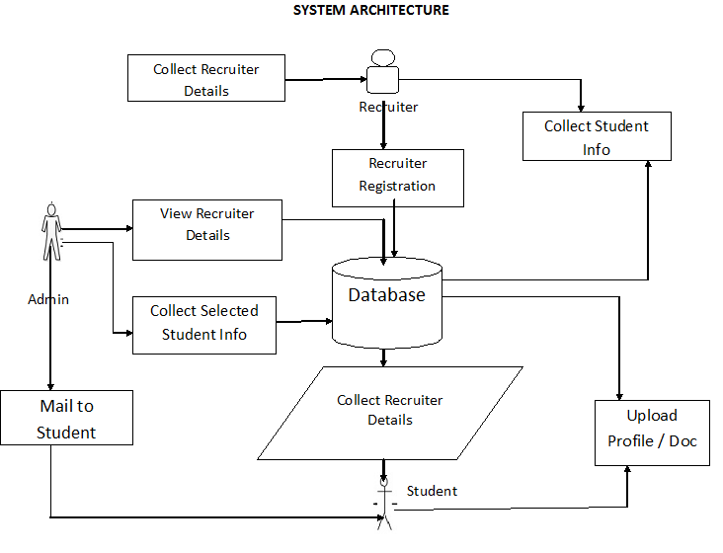
SYSTEM ARCHITECTURE

Slide 12
PROJECT MODULES:
There are mainly 3 modules in the project “Training and Placement Cell“
They are:
Student module.
Administrator module.
Recruiter module.

Slide 13
STUDENT MODULE:
In this module, creation of student input records about academic career from SSLC, HSC and all semester with facilities to modify the records and viewing changed records. The Student views the company details and verifies particular company details and provides valid details for registration.
Update details: This service provides the user to update their details.
Check details: This service provides the user to check his details.
Material: This service provides the user to check for materials uploaded by administrator

Slide 14
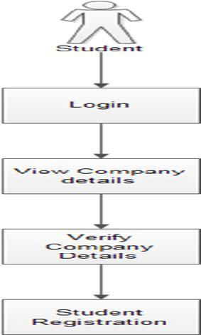
STUDENT MODULE (Contd..,)

Slide 15
ADMINISTRATOR MODULE:
The admin is the placement officer who views the students details and company details and post the selected students list. Sending email to student for complete list of information for particular campus. Indication of hall ticket issued to candidates through mail. Login, View company details, View selected students details, Sending mail.
Update details: Allows administrator to update his (college) details.
Update statistics: Allows administrator to insert/update statistics like no. Of students selected etc.
Add student: Allows administrator to add a student to database.

Slide 16
ADMINISTRATOR MODULE (Contd.,)
Add recruiter: Allows administrator to add a recruiter to database.
Add event: Allows administrator to add/insert an event.
Approve: Allows administrator to verify the details of the student, and to Approve him to the application if they are correct.
Student details: Allows administrator to search for student information According to eligibility criteria for recruitment process.
Change password: This service enables the administrator to change password.

Slide 17
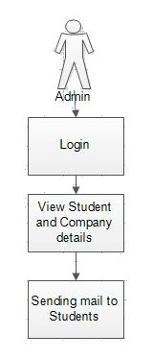
ADMINISTRATOR MODULE (Contd.,)

Slide 18
RECRUITER MODULE :
The company enrolls themselves and they register their profile and their will marquee in the main page till their drive and view the student’s details and update their details.
Update details: Allows administrator to update his (college) details.
Update statistics: Allows administrator to insert/update statistics like no. Of students selected etc.

Slide 19
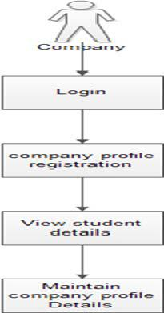
RECRUITER MODULE :

Slide 20
CONCLUSION
This project has emphasised the diversity of the sector and also the unique contribution it makes to student education and training. Perception and practice in the provision of student placements is also diverse and follows no recognisable pattern. Attitudes, documentation and relationships are not related to the size or scope of a particular organization.
A positive attitude is not necessarily an indicator of integrated structures to support neither student placements nor engagement in student placement related activities.
The long-term goal of this project is to support the sector to contribute to the development of a skilled mental health workforce.

Slide 21
FUTURE WORK:-
The application developed is simple prototype to explain the basic functionalities of the upcoming application. In the upcoming release following features will be added
Conducting mock tests is to be added.
Emailing to eligible student is to be added.
In proposed online placement system there is scope for improvement of the system. System is not providing the SMS integration. Hence, it can be modified to give the SMS integration.
Apart from these there is scope for generating many more features

Slide 22
REFERENCES:
Mr R J LAIRD,“ Interactive Web-based Placement Management–Principles and Practice using OPUS”, School of Eng
Gaurav Chheda, Niket Gajra, Manal Chhaya, Jitesh Deshpande, Saylee Gharge, ”STUDENT PLACEMENT SYSTEM”, International Journal of Soft Computing and Engineering (IJSCE) ISSN: 2231-2307, Volume-1, Issue-6, January 2012.
Juan Zambada, Ricardo Quintero, Ramon Isijara, Ricardo Galeana, Luis Santillan, “An IoT based scholar bus monitoring system”, Smart Cities Conference (ISC2), 2015 IEEE First International, IEEE Xplore: 28 December 2015, DOI: 10.1109/ISC2.2015.7366202 .

Slide 23
REFERENCES: (Contd.,)
4. NileshRathod, Seema Shah, KavitaShirsat,”An Interactive Online Training & Placement System”, International Journal of Advanced Research in Computer and Communication Engineering, Vol. 3, Issue 12,December-2013.
5. Hitesh Kasture, SumitSaraiyya, AbhishekMalviya, PreetiBhagat,“Training & Placement Web Portal”, International Journal on Recent and Innovation Trends in Computing and Communication ISSN: 2321- 8169 Volume: 2 Issue: 3,March-2014.
6. Roger S Pressman, “Software Engineering – A Practitioner’s approach” McGraw – Hill International Editions, Fifth Edition, 2001.

Slide 24
Url:-
Source :https://www.tutorialspoint.com
Source :https://www.javatpoints.com
Source :http://www.di-mgt.com.au/rsa_alg.html
Source :https://www.ionicframework.com/docs
Source :https://www.firebase.com/docs

Slide 25
THANK YOU

